Slide 1

Data Nerds-Group #10
Milestone #2 Check-In

Slide 2

Bonds, Warranties, and Insurances required & Status:
Our Question?
How would the use of renewable energy affect construction sites in terms of cost , energy usage and carbon emissions within the middle east and African regions?
Commercial Status
Data Nerds- Group #10

Slide 3

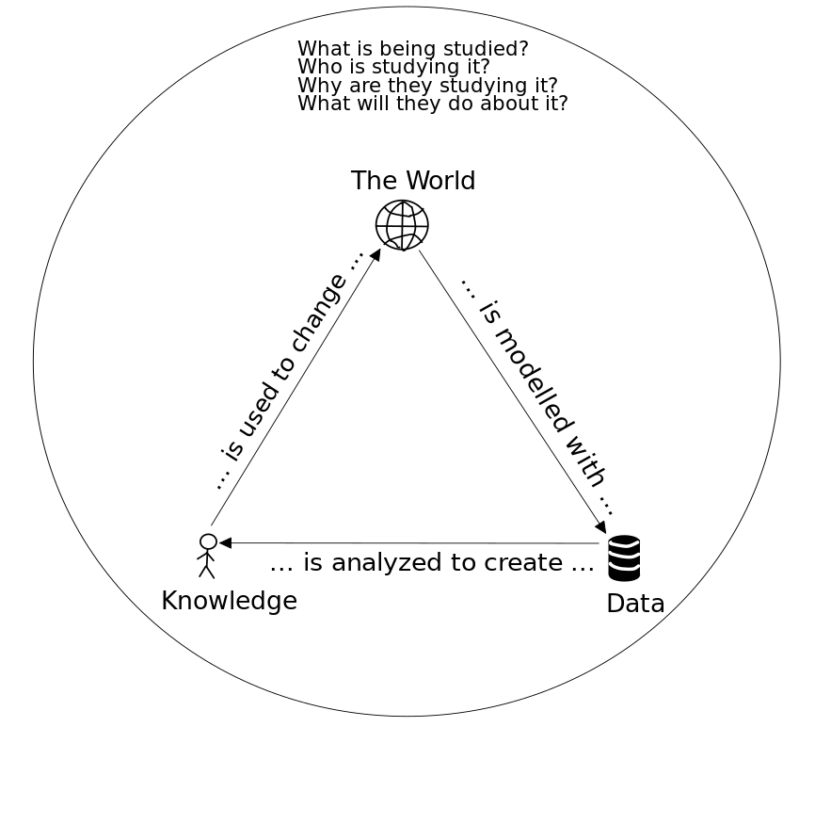
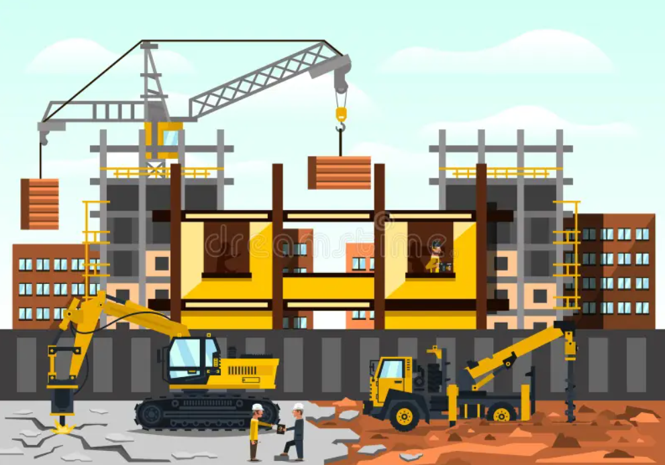
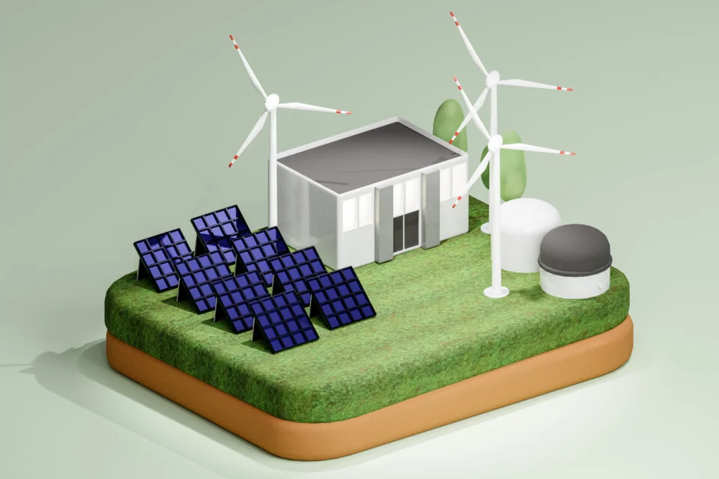
Research Brief

Slide 4
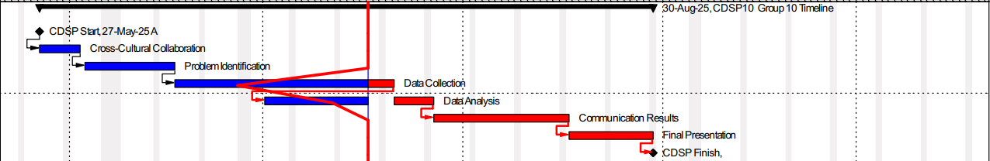
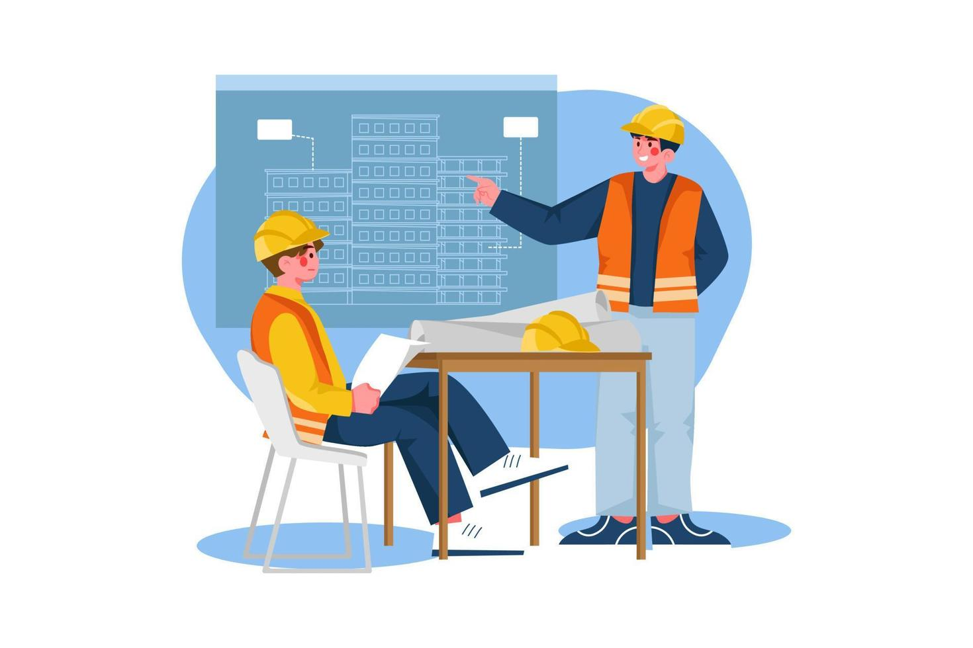
Timeline

Slide 5

Brief of Works
Data was collected via Google Forms. We’ve Obtained 20+ responses which is greater than we had expected. We’ve also been contacted by professionals working in the industry interested in our research.
We’ve proceeded with the data wrangling & cleaning
Example: Column Names, NULL Values, Grouped the data sets, unified the units of measurements
Through Excel & Colab
Next Steps will involve Analyzing the data in depth & Visualizing the results

Slide 6
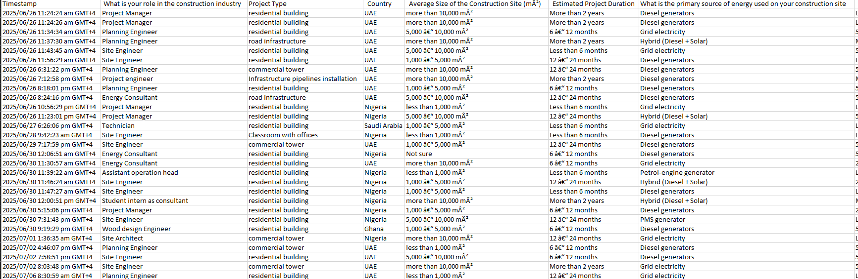
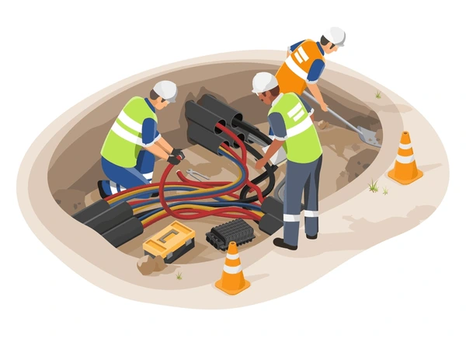

Slide 7
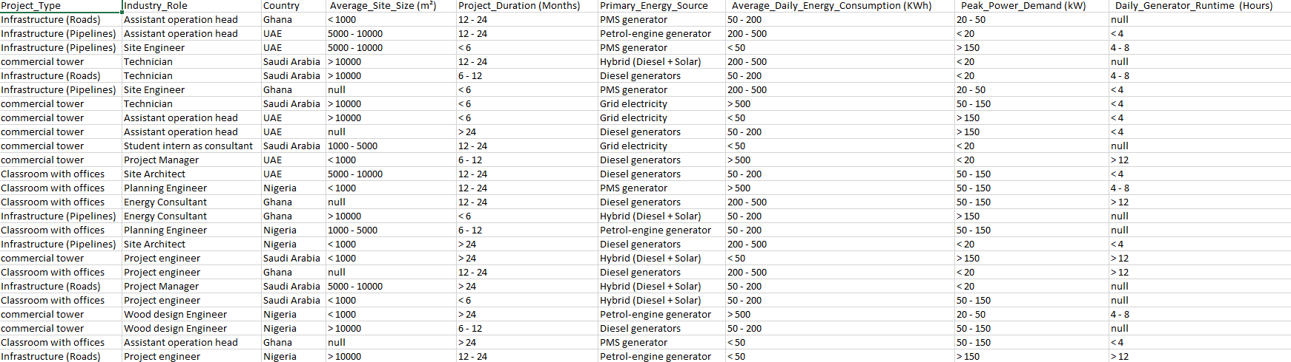


Slide 8

Risks & Mitigations
Risk
Mitigation Plan
In case of limited form responses
Generated Data through AI, and we’ll analyze both datasets and compare between the results

Slide 9
Thank You!

